Slide 1

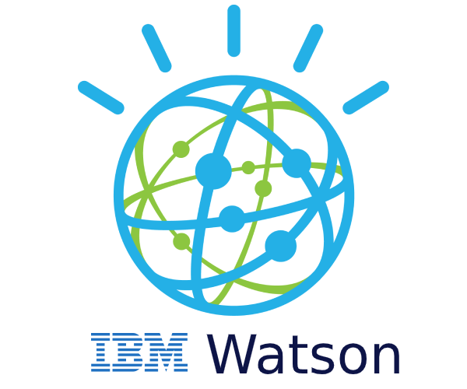

IBM Watson:
A look back at the historic Natural Language Processing, Quiz Show Question Answering, Cognitive Platform.
Darrell Collison
IST 664
Fall 2025
NLP Application

Slide 2
IBM: History
IBM was founded in 1911 as the Computing Tabulating Recording Company (CTR) whose major product was punch cards for mechanical tabulating systems.
As computing advanced to the digital age, they pivoted in the late 1950s to building computer mainframes for business and soon became the most valuable public corporation in the world.
The peak however may have led to a culture of corporate complacency and they soon failed to fully pivot as micro or “personal” computers became more popular with uses.
Their executives are often remembered as having scoffed at the idea that PCs could ever replace the functionality of mainframe computing for major business operations. However, PCs soon did replace the mainframe and IBM went through several major periods of contraction.
In 2011 Virginia Marie Rometty was appointed CEO of IBM. She became the first woman CEO of IBM, but was also the first non-MBA and engineer to lead the company since mathematician T. Vincent Learson (1971- 1973). (Hempel)
After decades of declining revenues, she vowed to return the company to its innovative roots, and fast-tracked approval for several new products including, IBM Cloud, Quantum computing productions, and Watson.

Slide 3
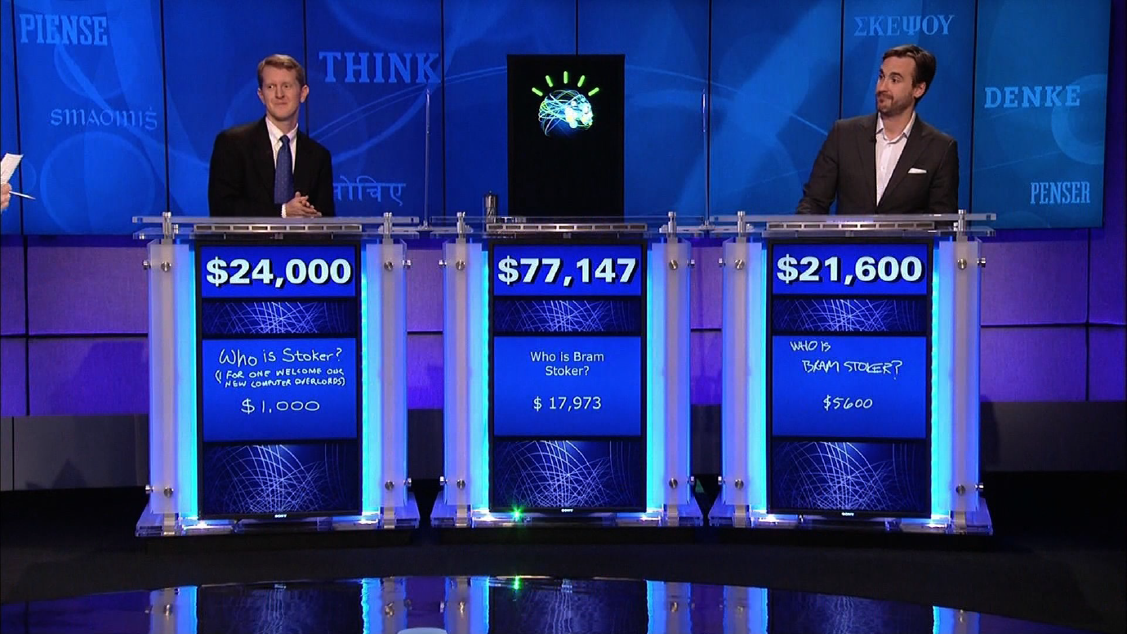

Slide 4
What is IBM Waston?
IBM Watson began as a project in 2004 after the company’s research manager Charles Lickel, saw Ken Jennings compete in Jeopardy during his historic 74 game win streak.
After the success they had developing Deep Blue, which in 1996 became the first computer to win a game of chess and then match against a reigning world champion (Garry Kasparov) under regular time controls, the research team sought new challenges to the tools they were building.
Rob High, CTO of IBM Watson Solutions said that Watson represented a first step into cognitive systems, a new era of computing. It builds on the current era of programmatic computing but differs in significant ways, through the combination of the following capabilities:
Natural language processing by helping to understand the complexities of unstructured data, which makes up as much as 80 percent of the data in the world today
Hypothesis generation and evaluation by applying advanced analytics to weigh and evaluate a panel of responses based on only relevant evidence
Dynamic learning by helping to improve learning based on outcomes to get smarter with each iteration and interaction
Although none of these capabilities alone were unique to Watson, the combination delivered a powerful solution, enabling computers to move from reliance on structured, local data, and decision tree-driven, deterministic applications to probabilistic systems that process and respond to unstructured data prompts

Slide 5






What is IBM Waston?
Cognitive AI Platform
Advanced Algorithms
Watson is a comprehensive cognitive AI platform that understands, reasons, learns, and interacts using natural language and unstructured data—going far beyond traditional computing.
Employs over 100 sophisticated algorithms including machine learning, natural language processing, and automated reasoning to deliver intelligent insights.
Language
Speech
Vision
Natural language understanding and generation
Voice recognition and synthesis
Image analysis and recognition
Discovery
Knowledge
Data mining and insights
Customizable learning models

Slide 6
How Waston Reasons
First, when a question is presented to Watson, it parses the question to extract its major features.
It then generates a set of hypotheses by looking across the corpus for passages that have some potential for containing a valuable response
It performs a deep comparison of the language of the question and the language of each potential response by using various reasoning algorithms.
This step is challenging. There are hundreds of reasoning algorithms, each of which does a different comparison.
For example, some look at the matching of terms and synonyms, some look at the temporal and spatial features, and some look at relevant sources of contextual information.
Each reasoning algorithm produces one or more scores, indicating the extent to which the potential response is inferred by the question based on the specific area of focus of that algorithm.
Each resulting score is then weighted against a statistical model that captures how well that algorithm did at establishing the inferences between two similar passages for that domain during the “training period” for Watson. That statistical model can then be used to summarize a level of confidence that Watson has about the evidence that the candidate answer is inferred by the question.
Watson repeats this process for each of the candidate answers until it can find responses that surface as being stronger candidates than the others.

Slide 7
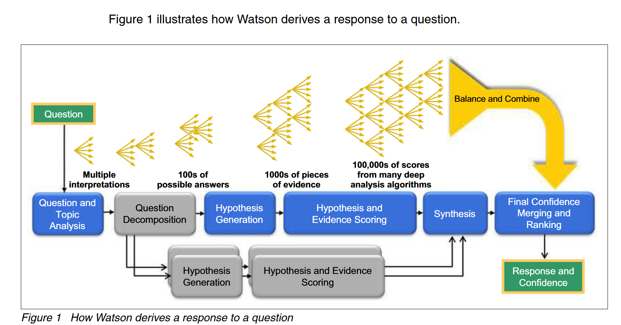
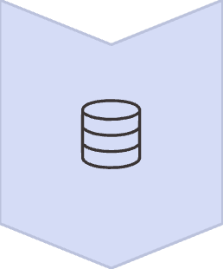

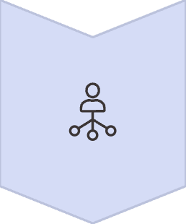
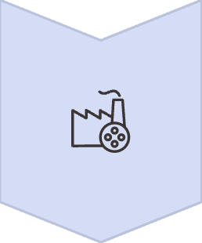

Waston’s Intelligent Architecture
Data Ingestion
Captures structured and unstructured
data from multiple sources
NLP Processing
Analyzes language, context, and
sentiment with deep understanding
Machine Learning
Applies algorithms to identify patterns
and generate insights
Intelligent Output
Delivers actionable recommendations
and responses

Slide 8
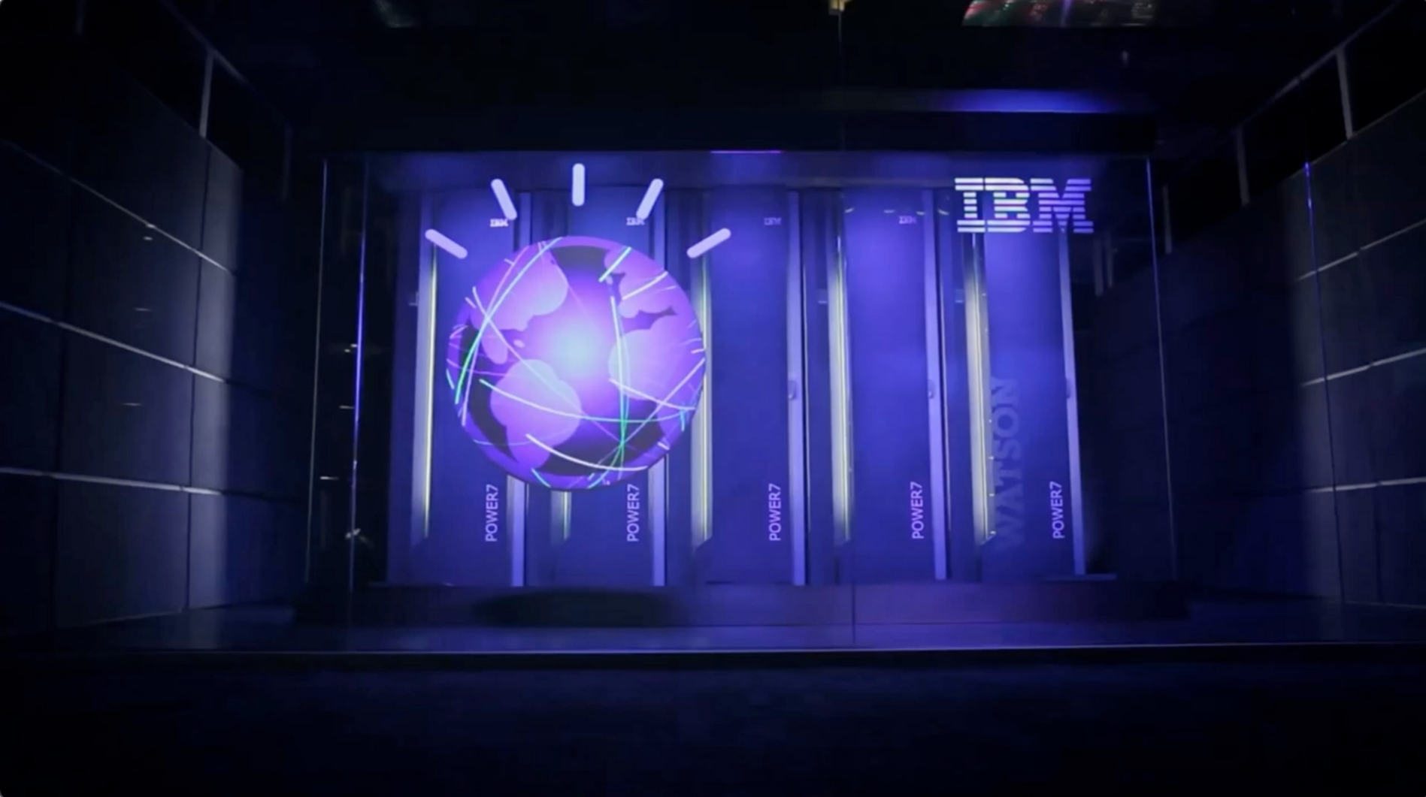

Waston’s Impact: A Historic AI/ NLP Breakthrough
01
02
03
Jeopardy! Victory
DeepQA Innovation
New Era Begins
In 2011, Watson defeated human champions Ken Jennings and Brad Rutter, showcasing revolutionary natural language understanding capabilities that stunned the world.
Developed by IBM's DeepQA team led by David Ferrucci, Watson processed 200 million pages of data without internet access, relying purely on cognitive computing power.
This historic moment marked the beginning of a new era in cognitive computing, proving AI could understand context, nuance, and complexity at unprecedented levels through the use of natural language processing models.

Slide 9
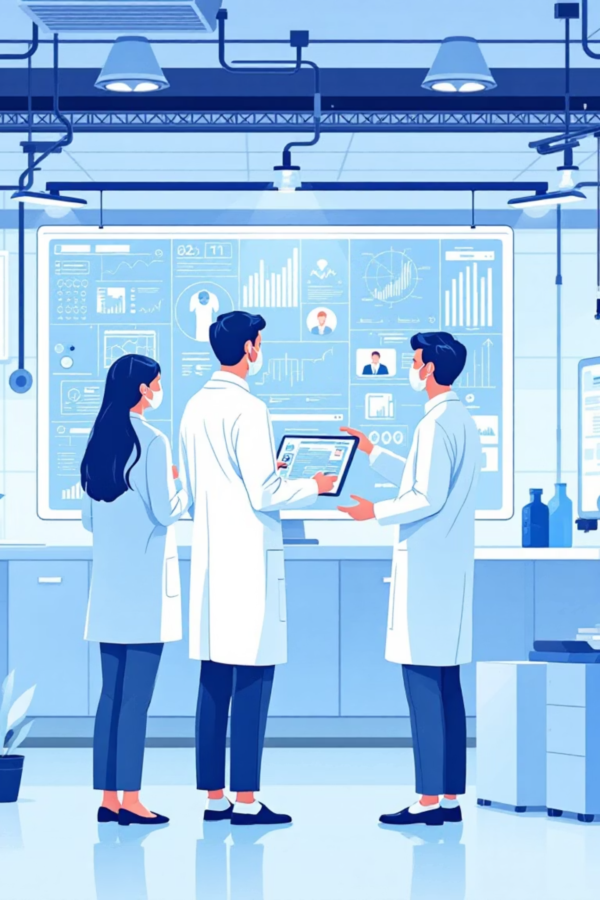

Waston’s Impact: 5 Key Use Cases
Medical Literature Analysis
Analyzes vast repositories of medical literature and patient data to support evidence-based clinical decision-making and treatment planning.
Customer Service Automation
AI-powered chatbots deliver 30-50% faster response times and 20% higher satisfaction in retail and telecommunications.
Legal Contract Analysis
Cuts document review time by 50%, automatically highlighting risks and compliance issues for legal teams.
Clinical Partnerships
Growing adoption across healthcare systems shows measurable improvements in patient engagement, diagnostic speed, and treatment outcomes.
Financial Fraud Detection
Achieves 25% reduction in fraud losses with improved compliance monitoring and real-time threat detection in banking.

Slide 10
Waston’s Impact
Watson was a significant milestone in AI, particularly for natural language processing and machine learning, demonstrating how AI could handle the complexities of human language and answer trivia clues posed with puns and wordplay.
“Watson’s ability to incorporate facets of artificial intelligence (AI), such as machine learning, expert system, and natural language processing represented a substantial step forward from Deep Blue, and ushered in a new era of computing: The ‘cognitive’ era.” (Yang)
While Watson was ultimately surpassed by many products such as Google’s Gemini and OpenAI's ChatGPT, Watson paved the way for modern AI by proving the commercial viability and power of natural language processing (NLP).
Watson's public success encouraged researchers and businesses to explore practical applications for cognitive systems in critical fields like healthcare and law, moving AI out of academic labs and into the enterprise.
It also helped set the stage for subsequent innovations like the Large Language Models (LLMs) that power ChatGPT.
One of the major differences between Watson and modern LLM based apps are the ArchitecturalDifferences.
The original Jeopardy!-winning Watson (2011) used a "DeepQA" approach, which was an ensemble of many different algorithms for hypothesis generation and evidence scoring. ChatGPT, by contrast, is built on the Transformer architecture (introduced in a 2017 research paper Attention Is All You Need), which uses a self-attention mechanism to process vast amounts of data more efficiently and contextually.

Slide 11



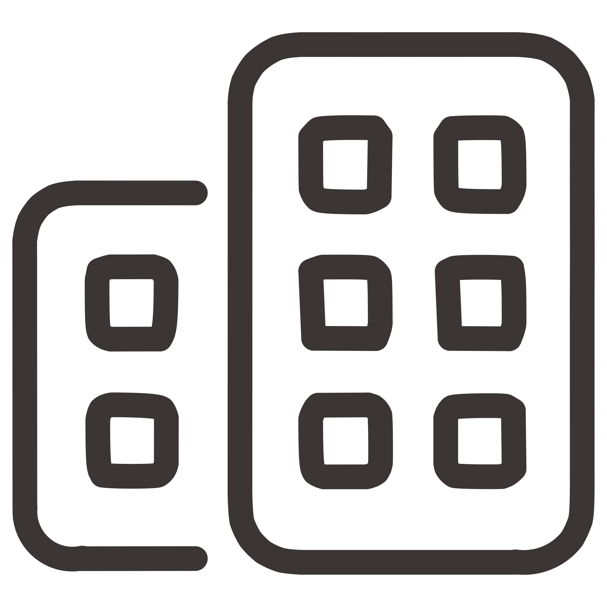
From Jeopardy! to Enterprise AI: Watson's Evolution
Quiz Show Marvel
Watson began as a groundbreaking demonstration of AI capabilities, capturing global attention with its Jeopardy! victory.
Cloud-Based Platform
Transitioned to a powerful cloud-based AI platform designed to solve real business challenges across industries.
Industry Solutions
Developed tailored AI applications for healthcare, finance, customer service, supply chain, and legal sectors with enterprise-grade security.
Watson's journey reflects IBM's commitment to transforming AI from experimental technology into practical business solutions that drive measurable results.

Slide 12
References
Hempel, Jessi. IBM’s Ginni Rometty looks ahead. Fortune Magazine, September 20, 2012. https://fortune.com/2012/09/20/ibms-ginni-rometty-looks-ahead/
High, Rob et al. In collaboration with the International Technical Support Organization (ITSO) of IBM Research. The Era of Cognitive Systems: An Inside Look at IBM Watson and How it Works. Redguides for Business Leaders. http://www.ibm.com/innovation/us/watson/index.shtml
Yang, Jialei et al. The Rise, Fall, and Resurrection of IBM Watson Health. UC Berkeley and University of Oulu, Research Project 2019 Fall, Published 2020 https://corporateinnovation.berkeley.edu/wp-content/uploads/2020/04/The-Rise-Fall-and-Resurrection-of-IBM-Watson-Health_final.pdf
IBM Watson to watsonx https://www.ibm.com/watson?mhsrc=ibmsearch_a&mhq=watson
Slidebean YouTube Channel. How IBM Got Crushed by ChatGPT. August 6, 2024. https://www.youtube.com/watch?v=JLiknq5SV0A
AI assistance from Google Gemini for comprehensive search overview, and Gamma for Ppt template construction.

Slide 13

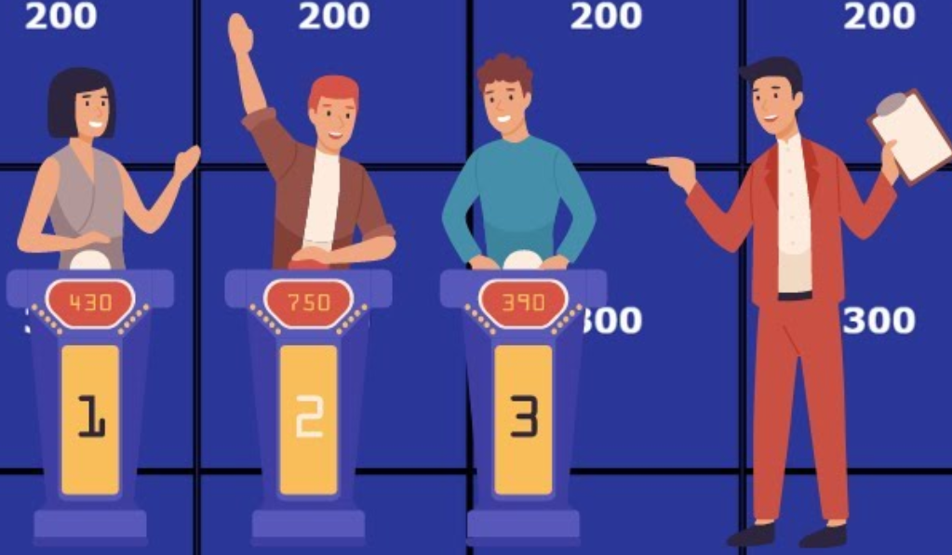
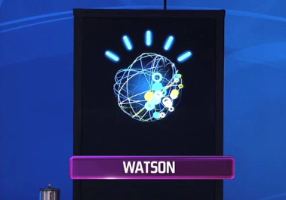
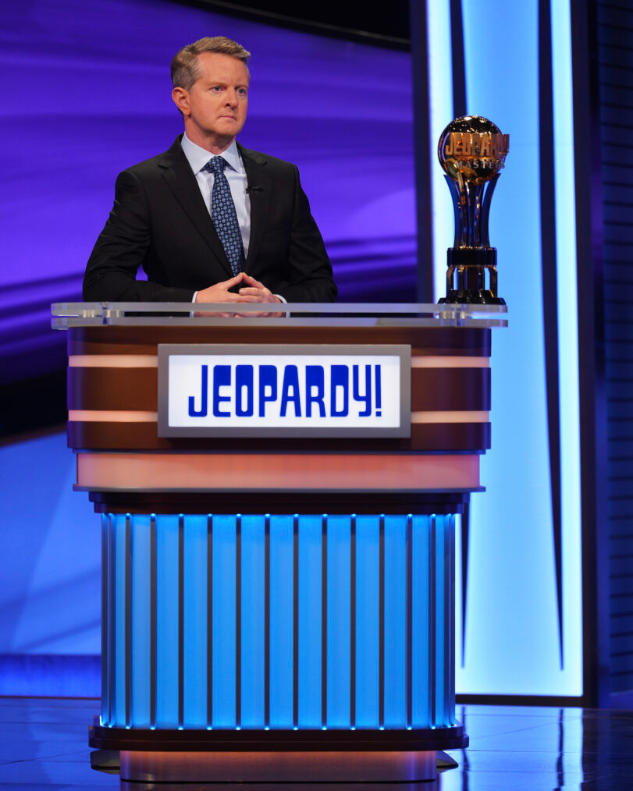
Questions??

